Slide 1
Accessible Audiobooks Made Easy
One million titles for you!

Slide 2
Project Partners
•The Centre for Equitable Library Access, CELA, is an accessible library service, providing books and other materials to Canadians with print disabilities.
•The Manitoba Accessibility Fund provides grants to help organizations in Manitoba remove barriers, create awareness and support compliance with The Accessibility for Manitobans Act and its standards.

Slide 3
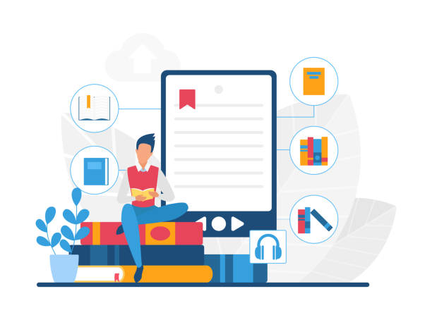
Audiobooks are an invaluable resource for anyone who struggles with reading print books

Slide 4
From visual impairment to arthritis, there are many conditions that can impede the ease of just “picking up a book”
Audiobooks are a fantastic tool for people with ANY condition that makes it difficult or impossible to read standard print

Slide 5
Challenges to reading print
Vision issues such as partial or full blindness
Physical conditions that make it difficult to hold a book or turn pages
Challenges relating to the comprehension of print

Slide 6
Benefits to reading
Helps continue engagement in lifelong interests
Reduces cognitive decline
Builds empathy
Provides entertainment
Increases literacy and vocabulary
Offers opportunities to learn something new

Slide 7
New service from South Interlake Regional Library
“Literacy for All Manitobans” project
Easy to use audiobook players
Kit comes with everything you need
Free
Use Inter-Library Loan through any rural library in Manitoba to borrow

Slide 8
Easy to use
Audiobook players are preloaded with titles
Players are sturdy and have clear instructions
Listen in comfort – with or without headphones

Slide 9
Obstacles we identified
We realized that dedicated audiobook players are expensive
Technical knowledge is needed to download titles
Many users have wifi access issues

Slide 10
Our solutions
Purchased audiobook players through a grant from the Manitoba Accessibility Fund
Created kits for borrowing
Pre-downloaded titles
No internet required to play books

Slide 11
One million titles!
Centre for Equitable Library Access – CELA,
has 1,000,000 titles to choose from
Fiction, non-fiction, award winners, Canada Reads, Scotiabank Giller Awards and more
Book for all ages

Slide 12
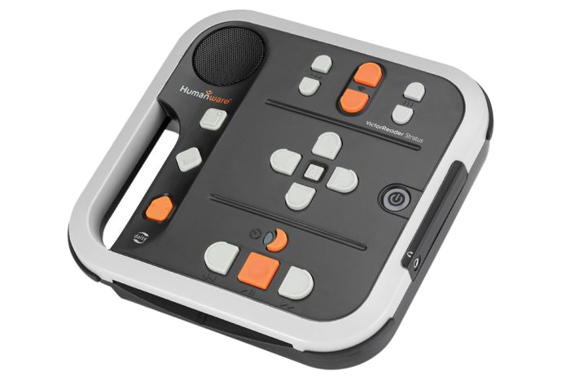
Easy listening
Each player has titles in the same genre
All titles are recorded with a human voice

Slide 13
Choose from
Western
Romance
Historical Fiction
Mystery, Crime and Suspense
Non-fiction and Biography
Recent Bestsellers

Slide 14
How to borrow
Ensure client is a member of the local library (free service)
Borrow the kit through inter-library loan using your library card
Loan period is 6 weeks
Provincial launch date: April 29

Slide 15
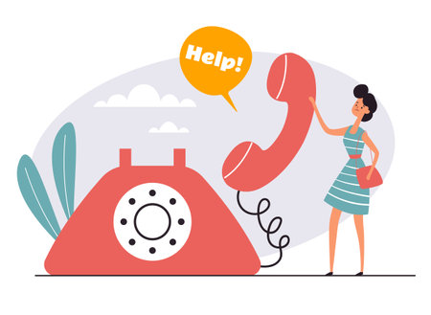
Continued Library support
Staff will meet with you and explain how to use the machine
We will give you a follow up phone call to answer any questions

Slide 16
Any questions?

Slide 17
Thank you
South Interlake Regional Library
419 Main Street
Stonewall MB R0C 2Z0
204-467-5767
ccurle@sirlibrary.com

